Slide 1


Maxima and Minima

Slide 2
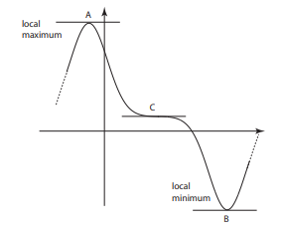
The diagram below shows part of a function y = f(x)

Slide 4
At the point (a, b)
If $\frac{dy}{dx}$ = 0
Case-1 $\frac{d^{2}y}{dx^{2}}<0$, then the point (a, b) is a local maximum
Case-2 $\frac{d^{2}y}{dx^{2}}>0$, then the point (a, b) is a local minimum

Slide 5
Example : Find the stationary point of the function y = $x^{2}−2x−3$ and hence determine the nature of this point.

Slide 6
Which of the following points is a local maximum of the function y = $2x^{3}−15x^{2}−36x+6$?
(a) (−3, 15), (b) (−6, 25), (c) (−2, 25), (d) (−1, 25).

Slide 7
Which of the following statements is true for the function y = $x+1+\frac{1}{x}$ ?
(a) (1, 3) is a local maximum
(b) (1, −3) is a local minimum
(c) (−1, 1) is a local minimum
(d) (−1, −1) is a local maximum

Slide 8
Which of the following statements is true for the function y = $\frac{x^{2}}{2}−cosx$?
$\left(\frac{π}{2},\frac{π^{2}}{8}\right)$ is a local minimum
$\left(\frac{π}{2},\frac{π^{2}}{8}\right)$ is a local maximum
(0, −1) is a local minimum
(0, −1) is a local maximum.

Slide 9
GATE CS 2012
Consider the function f(x) = sin(x) in the interval [$\frac{π}{4}$, $\frac{7π}{4}$]. The number and location(s) of the local minima of this function are (A) One, at $\frac{π}{2}$ (B) One, at $\frac{3π}{2}$ (C) Two, at $\frac{π}{2}$ and $\frac{3π}{2}$ (D) Two, at $\frac{π}{4}$ and $\frac{3π}{2}$
Answer: (D)

Slide 10
GATE CS 2008
A point on a curve is said to be an extremum if it is a local minimum or a local maximum. The number of distinct extrema for the curve 3x⁴ – 16x³ + 24x² + 37 (A) 0 (B) 1 (C) 2 (D) 3
Answer: (B)

Slide 11
GATE CS 1997
What is the maximum value of the function f(x) = 2x²-2x+6 in the interval [0,2] ? (A) 6 (B) 10 (C) 12 (D) 5.5
Answer: (B)

Slide 12
GATE-CS-2015 (Set 2)
Consider a function f(x) = 1 – |x| on –1 ≤ x ≤ 1. The value of x at which the function attains a maximum and the maximum value of the function are: (A) 0, –1 (B) –1, 0 (C) 0, 1 (D) –1, 2
Answer: (C)

Slide 13
ISRO CS 2017
If x = -1 and x = 2 are extreme points of f(x) = α log |x| + β x² + x then
(A) α = -6, β = -1/2 (B) α = 2, β = -1/2 (C) α = 2, β = 1/2 (D) α = -6, β =1/2
Answer: (B)

Slide 14
ISRO CS 2017
Let f(x) = log|x| and g(x) = sin x . If A is the range of f(g(x)) and B is the range of g(f(x)) then A ∩ B is
(A) [-1, 0] (B) [-1, 0) (C) [-∞, 0] (D) [-∞,1]
Answer: (A)

Slide 15
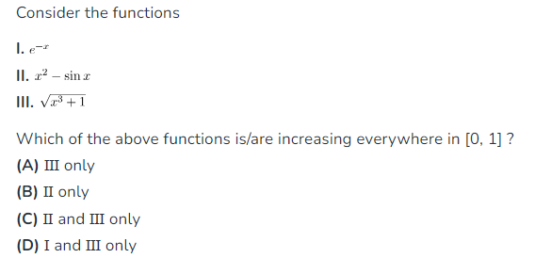
GATE CS 2020
Answer: (a)

Slide 16

GATE CS 2016
Answer: 9

Slide 17
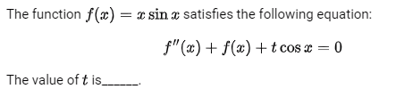
GATE CS 2014
Answer: -2

Slide 18
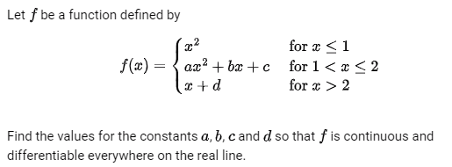

GATE CS 1996

Slide 19
Indefinite Integrals –
Definition :Let f(x) be a function. Then the family of all first antiderivatives is called the indefinite integral of a function f(x) and it is denoted by $\int{f(x)dx}$.
The symbol $\int{f(x)dx}$ is read as the indefinite integral of f(x) with respect to x. Thus $\int{f(x)dx=φ(x)+C}$.
Thus, the process of finding the indefinite integral of a function is called integration of the function.

Slide 20
Fundamental Integration Formulas –
∫x^{n}dx = (x^{n+1}/(n+1))+C
∫(1/x)dx = (log_{e}|x|)+C
∫e^{x}dx = (e^{x})+C
∫a^{x}dx = ((a^{x})/(log_{e}a))+C
∫sin(x)dx = -cos(x)+C
∫cos(x)dx = sin(x)+C
∫sec²(x)dx = tan(x)+C

Slide 21
8. ∫cosec²(x)dx = -cot(x)+C
9. ∫sec(x)tan(x)dx = sec(x)+C
10. ∫cosec(x)cot(x)dx = -cosec(x)+C
11. ∫cot(x)dx = log|sin(x)|+C
12. ∫tan(x)dx = log|sec(x)|+C
13. ∫sec(x)dx = log|sec(x)+tan(x)|+C
14. ∫cosec(x)dx = log|cosec(x)-cot(x)|+C

Slide 22
Example. Evaluate $\int{x^{4}dx}$.

Slide 23
Example. Evaluate $\int{\frac{2}{1+cos2x}dx}$.

Slide 24
Example. Evaluate $\int{\frac{x^{3}−x^{2}+x−1}{x−1}dx}$.

Slide 25
Integration by substitution
Example .Evaluate the $\int{x^{2}e^{x^{3}}dx}$

Slide 26
Example 2.Evaluate the ∫ sin²(x) cos(x)dx

Slide 27
Integration by Parts :
Theorem :If u and v are two functions of x, then
∫(uv)dx = u(∫vdx)-∫(u'∫vdx)dx
where u is a first function of x and v is the second function of x

Slide 28
Example .Evaluate the ∫x sin(3x)dx

Slide 29
Integration by partial fraction
Example $\int{\frac{\left(x−1\right)}{\left(x+1)(x−2\right)}dx}$

Slide 30
Example$\int{\frac{cosx}{\left(2+sinx)(3+4sinx\right)}dx}$

Slide 31
Definite Integral
We need the definite integral of the function f(x) with respect to x from a to b to be
$\int_{a}^{b}{f(x)dx}={\left.\left.F(x\right)\right|}_{a}^{b}=F(b)−F(a$)
where F(x) is the anti-derivative of f(x).
We call a and b the lower and upper limits of integration respectively.
The function being integrated, f(x), is called the integrand.

Slide 32
Example Calculate the definite integral
(i) $\int_{1}^{2}{x^{4}dx}$ (ii) $\int_{0}^{π}{sinxdx}$

Slide 33
Example Calculate the definite integral
(i) $\int_{−2}^{2}{|x|dx}$ (ii) $\int_{0}^{2π}{|sinx|dx}$

Slide 34
PROPERTIES OF DEFINITE INTEGRAL
1. $\int_{a}^{b}{f(x)dx}=\int_{a}^{b}{f(t)dt}$
2. $\int_{a}^{b}{f(x)dx}=−\int_{b}^{a}{f(x)dx}$
3. $\int_{a}^{b}{f(x)dx}=\int_{a}^{c}{f(x)dx}+\int_{c}^{b}{f(x)dx}$
4. $\int_{a}^{b}{f(x)dx}=\int_{a}^{b}{f(a+b−x)dx}$
5. $\int_{0}^{a}{f(x)dx}=\int_{0}^{a}{f(a−x)dx}$

Slide 35
6. $\int_{−a}^{a}{f(x)dx}=\left\{\begin{matrix}2\int_{0}^{a}{f(x)dx} ,f\left(x\right) is even \\ 0 ,f\left(x\right) is odd\end{matrix}\right.$
7. $\int_{0}^{2a}{f(x)dx}=\left\{\begin{matrix}\left.2\int_{0}^{a}{f(x)dx} ,f(2a−x)=f(x\right) \\ \left.0 ,f(2a−x)=−f(x\right)\end{matrix}\right.$

Slide 36
Example: $\int_{0}^{2π}{sinxdx}$

Slide 37
Example : $\int_{−π/2}^{π/2}{\frac{sin2x}{1+cosx}dx}$

Slide 38
Example: $\int_{0}^{a}{\frac{\sqrt{x}}{\sqrt{x}+\sqrt{a−x}}dx}$

Slide 39
GATE-CS-2014-(Set-3)
If $\int_{0}^{2π}{|xsinx|dx}=kπ$ then the value of k is equal to __________. (A) 2 (B) 3 (C) 4 (D) 5
Answer: (C)

Slide 40
GATE CSE 2015 Set 1
$$\int_{1/π}^{2/π}{\frac{\left.cos(1/x\right)}{x^{2}}dx}$$
Answer:(-1)

Slide 41
GATE CSE 2001
The value of the integral is I = $\int_{0}^{π/4}{\cos^{2}xdx}$
$\frac{π}{8}+\frac{1}{4}$
$\frac{π}{8}−\frac{1}{4}$
$−\frac{π}{8}−\frac{1}{4}$
$−\frac{π}{8}+\frac{1}{4}$
Answer: (a)

Slide 42
GATE CS 2011 | Question 31
Given i=√-1, what will be the evaluation of the integral $\int_{0}^{π/2}{\frac{cosx+isinx}{cosx−isinx}dx}$ ? (A) 0 (B) 2 (C) -i (D) I

Slide 43

GATE-CS-2009 | Question 25
is equivalent to (A) 0 (B) 1 (C) ln 2 (D) 1/2 ln 2
Answer (D)

Slide 44
GATE-CS-2014-(Set-3)
The value of integral given below is: $\int_{0}^{π}{x^{2}cosxdx}$ (A) -2 $π$ (B) $π$ (C) - $π$ (D) 2 $π$
Answer: (A)

Slide 45
GATE CS 2018 | Question 25
The value of $\int_{0}^{π/4}{xcos(x^{2})dx}$ correct to three decimal places is _______ .
Answer: 0.289

Slide 46
GATE CSE 2005
What is the value of $\int_{0}^{2π}{{\left(x−π\right)}^{2}(sinx)dx}$
-1
0
1
$π$
Answer(b)

Slide 47
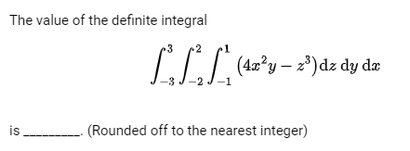
GATE CSE 2023
Answer(0)

Slide 48

GATE CSE 2008
Answer(13.5)

Slide 49
GATE-CS-2015 (Set 2)
Let f(x) = x ^{–(1/3)} and A denote the area of the region bounded by f(x) and the X-axis, when x varies from –1 to 1. Which of the following statements is/are True?
f is continuous in [–1, 1]
f is not bounded in [–1, 1]
A is nonzero and finite
(A) 2 only (B) 3 only (C) 2 and 3 only (D) 1, 2 and 3
Answer: (C)

Slide 50
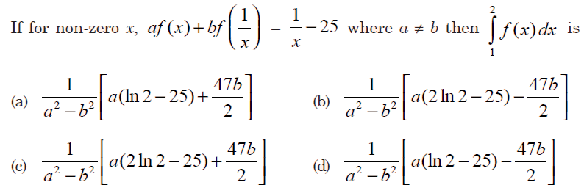
GATE-CS-2015 (Set 3)
(A) A (B) B (C) C (D) D

Slide 51
Answer: (A)

Slide 52

Thank you

